Slide 1
Data Mining Cluster Analysis: Advanced Concepts and Algorithms
Lecture Notes for Chapter 8
Introduction to Data Mining
by
Tan, Steinbach, Kumar
Introduction to Data Mining, 2nd Edition Tan, Steinbach, Karpatne, Kumar

Slide 2
Outline
Prototype-based
Fuzzy c-means
Mixture Model Clustering
Self-Organizing Maps
Density-based
Grid-based clustering
Subspace clustering: CLIQUE
Kernel-based: DENCLUE
Graph-based
Chameleon
Jarvis-Patrick
Shared Nearest Neighbor (SNN)
Characteristics of Clustering Algorithms

Slide 3
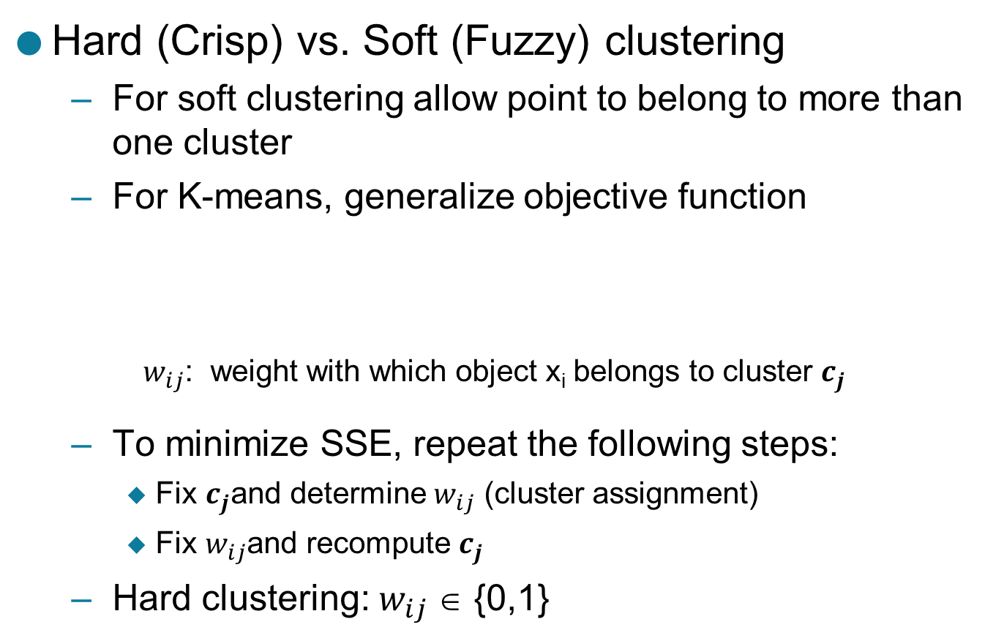
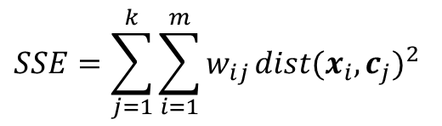
Hard (Crisp) vs Soft (Fuzzy) Clustering
Hard (Crisp) vs. Soft (Fuzzy) clustering
For soft clustering allow point to belong to more than one cluster
For K-means, generalize objective function
$w_{ij}$: weight with which object x_{i} belongs to cluster $c_{j}$
To minimize SSE, repeat the following steps:
Fix $c_{j}$and determine $w_{ij}$ (cluster assignment)
Fix $w_{ij}$and recompute $c_{j}$
Hard clustering: $w_{ij}$∈ {0,1}
$$SSE=\sum_{j=1}^{k}{\sum_{i=1}^{m}{w_{ij}}}{dist(x_{i},c_{j})}^{2}$$

Slide 4
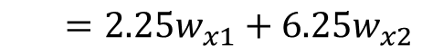
Soft (Fuzzy) Clustering: Estimating Weights
c₁
x
c₂
1
2.5
5
$$SSE=w_{x1}{\left(2.5−1\right)}^{2}+w_{x2}{\left(5−2.5\right)}^{2}$$
$={2.25w}_{x1}+{6.25w}_{x2}$
SSE(x) has a minimum value of 2.25 when w_{x1} = 1, w_{x2} = 0

Slide 5
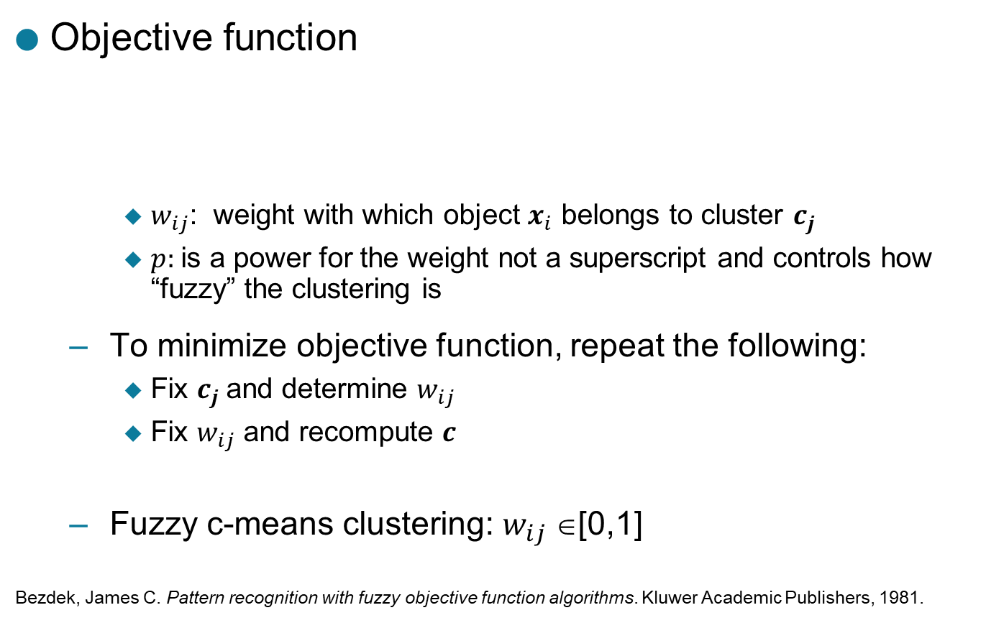
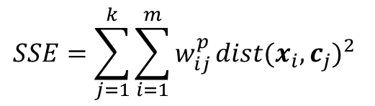
Fuzzy C-means
p: fuzzifier (p > 1)
Objective function
$w_{ij}$: weight with which object $x_{i}$ belongs to cluster $c_{j}$
$p:$is a power for the weight not a superscript and controls how “fuzzy” the clustering is
To minimize objective function, repeat the following:
Fix $c_{j}$and determine $w_{ij}$
Fix $w_{ij}$ and recompute $c$
Fuzzy c-means clustering: $w_{ij}$∈[0,1]
Bezdek, James C. Pattern recognition with fuzzy objective function algorithms. Kluwer Academic Publishers, 1981.
$$SSE=\sum_{j=1}^{k}{\sum_{i=1}^{m}{w_{ij}^{p}}}{dist(x_{i},c_{j})}^{2}$$

Slide 6
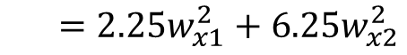
Fuzzy C-means
c₁
x
c₂
1
2.5
5
$$SSE=w_{x1}^{2}{\left(2.5−1\right)}^{2}+w_{x2}^{2}{\left(5−2.5\right)}^{2}$$
$={2.25w}_{x1}^{2}+{6.25w}_{x2}^{2}$
SSE(x) has a minimum value of 1.654 when w_{x1} = 0.74, w_{x2} = 0.36

Slide 7
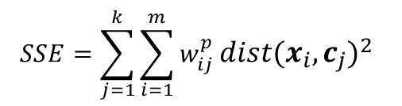
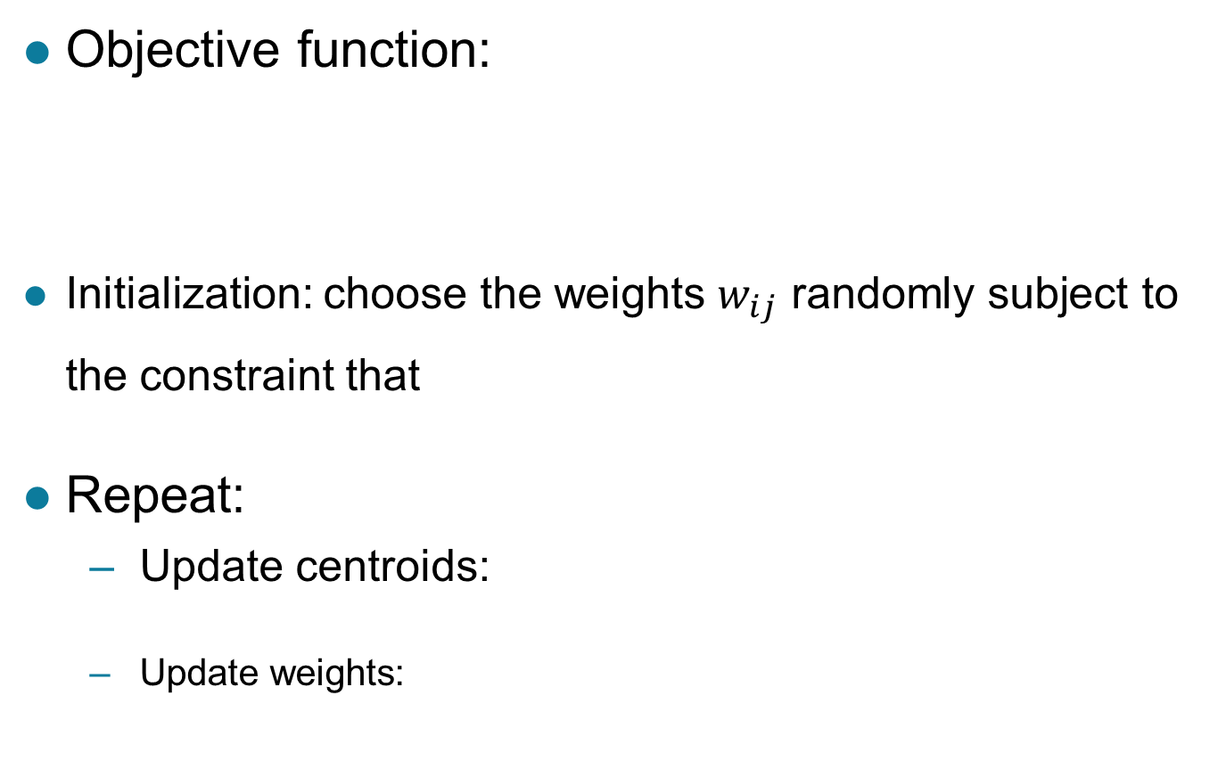
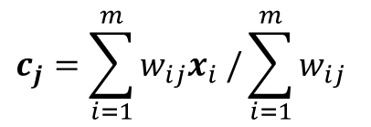
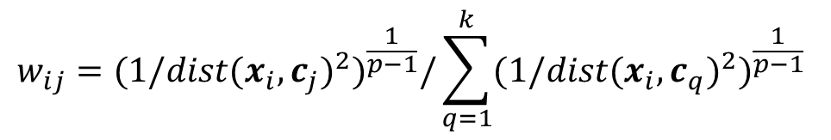
Fuzzy C-means
Objective function:
Initialization: choose the weights $w_{ij}$ randomly subject to the constraint that
Repeat:
Update centroids:
Update weights:
p: fuzzifier (p > 1)
$$SSE=\sum_{j=1}^{k}{\sum_{i=1}^{m}{w_{ij}^{p}}}{dist(x_{i},c_{j})}^{2}$$
$$c_{j}=\sum_{i=1}^{m}{w_{ij}x_{i} /}\sum_{i=1}^{m}{w_{ij}}$$
$$w_{ij}={{(1/dist(x_{i},c_{j})}^{2})}^{\frac{1}{p−1}}/\sum_{q=1}^{k}{{{(1/dist(x_{i},c_{q})}^{2})}^{\frac{1}{p−1}}}$$

Slide 8
Fuzzy K-means Applied to Sample Data

Slide 9
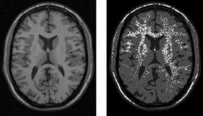
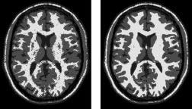
An Example Application: Image Segmentation
Modified versions of fuzzy c-means have been used for image segmentation
Especially fMRI images (functional magnetic resonance images)
References
Gong, Maoguo, Yan Liang, Jiao Shi, Wenping Ma, and Jingjing Ma. "Fuzzy c-means clustering with local information and kernel metric for image segmentation." Image Processing, IEEE Transactions on 22, no. 2 (2013): 573-584.
From left to right: original images, fuzzy c-means, EM, BCFCM
Ahmed, Mohamed N., Sameh M. Yamany, Nevin Mohamed, Aly A. Farag, and Thomas Moriarty. "A modified fuzzy c-means algorithm for bias field estimation and segmentation of MRI data." Medical Imaging, IEEE Transactions on 21, no. 3 (2002): 193-199.

Slide 10
Clustering Using Mixture Models
Idea is to model the set of data points as arising from a mixture of distributions
Typically, normal (Gaussian) distribution is used
But other distributions have been very profitably used
Clusters are found by estimating the parameters of the statistical distributions using the Expectation-Maximization (EM) algorithm
k-means is a special case of this approach
Provides a compact representation of clusters
The probabilities with which point belongs to each cluster provide a functionality similar to fuzzy clustering.

Slide 11
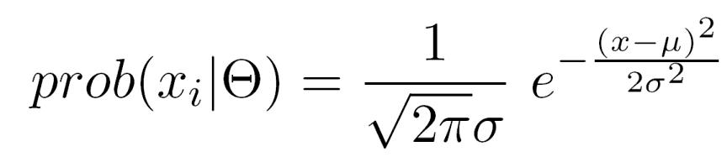
Probabilistic Clustering: Example
Informal example: consider modeling the points that generate the following histogram.
Looks like a combination of two normal (Gaussian) distributions
Suppose we can estimate the mean and standard deviation of each normal distribution.
This completely describes the two clusters
We can compute the probabilities with which each point belongs to each cluster
Can assign each point to the cluster (distribution) for which it is most probable.

Slide 12
Probabilistic Clustering: EM Algorithm
Initialize the parameters
Repeat
For each point, compute its probability under each distribution
Using these probabilities, update the parameters of each distribution
Until there is no change
Very similar to of K-means
Consists of assignment and update steps
Can use random initialization
Problem of local minima
For normal distributions, typically use K-means to initialize
If using normal distributions, can find elliptical as well as spherical shapes.

Slide 13
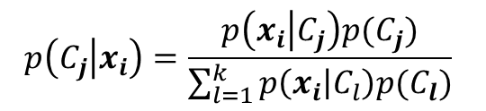
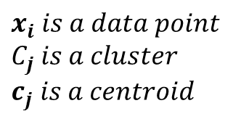
Probabilistic Clustering: Updating Centroids
Update formula for weights assuming an estimate for statistical parameters
Very similar to the fuzzy k-means formula
Weights are probabilities
Weights are not raised to a power
Probabilities calculated using Bayes rule:
Need to assign weights to each cluster
Weights may not be equal
Similar to prior probabilities
Can be estimated:
$$x_{i} is a data point$$
$$C_{j} is a cluster$$
$$c_{j} is a centroid$$
$$p\left(C_{j} | x_{i}\right)=\frac{p\left(x_{i} | C_{j}\right)p(C_{j})}{\sum_{l=1}^{k}{p\left(x_{i} | C_{l}\right)p(C_{l})}}$$

Slide 14
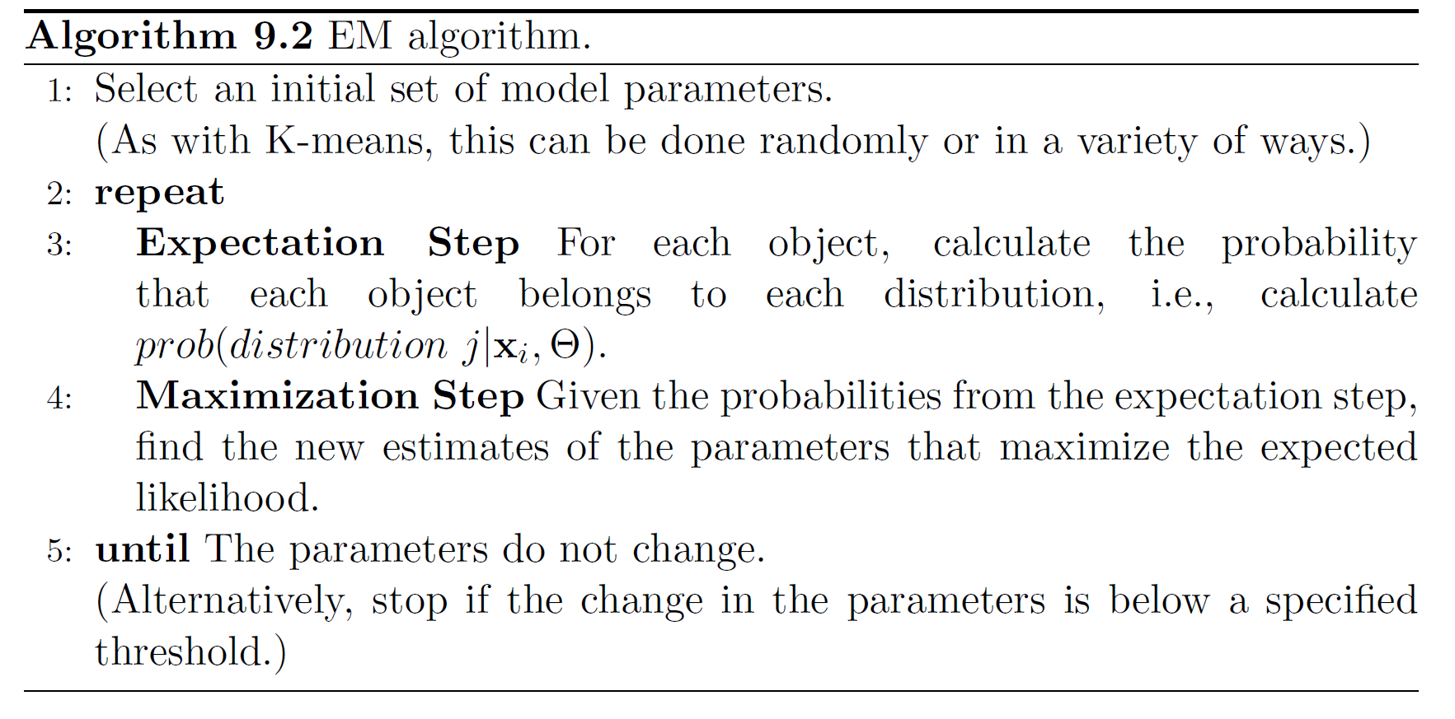
More Detailed EM Algorithm

Slide 15
Probabilistic Clustering Applied to Sample Data

Slide 16
Probabilistic Clustering: Dense and Sparse Clusters
?

Slide 17
Problems with EM
Convergence can be slow
Only guarantees finding local maxima
Makes some significant statistical assumptions
Number of parameters for Gaussian distribution grows as O(d²), d the number of dimensions
Parameters associated with covariance matrix
K-means only estimates cluster means, which grow as O(d)

Slide 18
Alternatives to EM
Method of moments / Spectral methods
ICML 2014 workshop bibliography https://sites.google.com/site/momentsicml2014/bibliography
Markov chain Monte Carlo (MCMC)
Other approaches

Slide 19
SOM: Self-Organizing Maps
Self-organizing maps (SOM)
Centroid based clustering scheme
Like K-means, a fixed number of clusters are specified
However, the spatial relationship of clusters is also specified, typically as a grid
Points are considered one by one
Each point is assigned to the closest centroid, and this centroid is updated
Other centroids are updated based on their spatial proximity to the closest centroid
Kohonen, Teuvo, and Self-Organizing Maps. "Springer series in information sciences." Self-organizing maps 30 (1995).

Slide 20
SOM: Self-Organizing Maps
Updates are weighted by distance
Centroids farther away are affected less
The impact of the updates decreases with each time
At some point the centroids will not change much
SOM can be viewed as a type of dimensionality reduction
If a 2D (3D) grid is used, the results can be easily visualized, and it can facilitate the interpretation of clusters

Slide 21
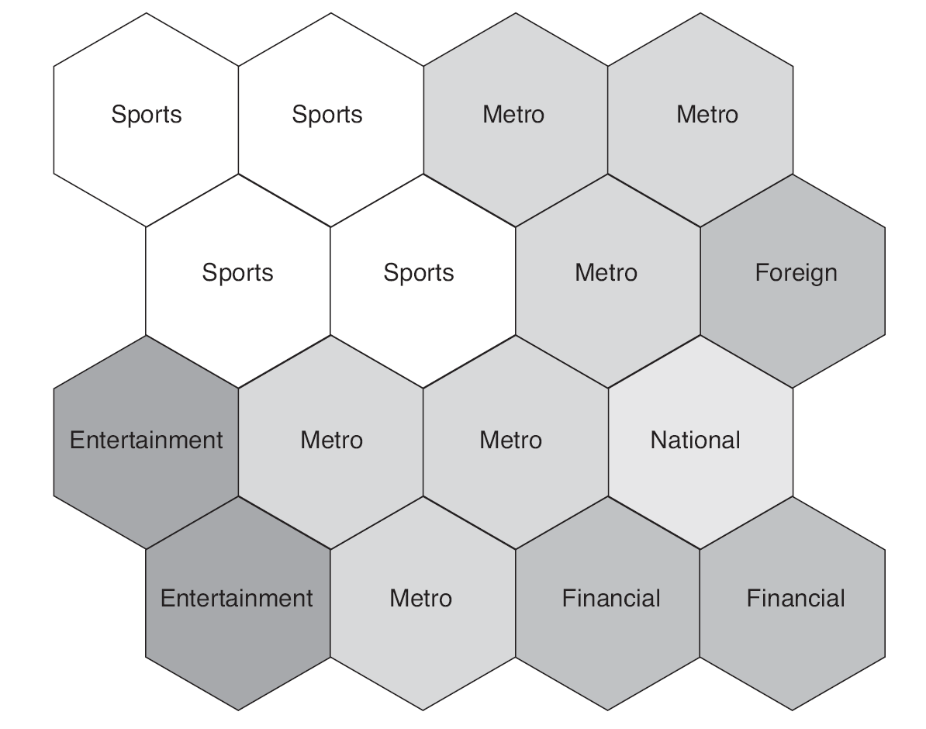
SOM Clusters of LA Times Document Data

Slide 22
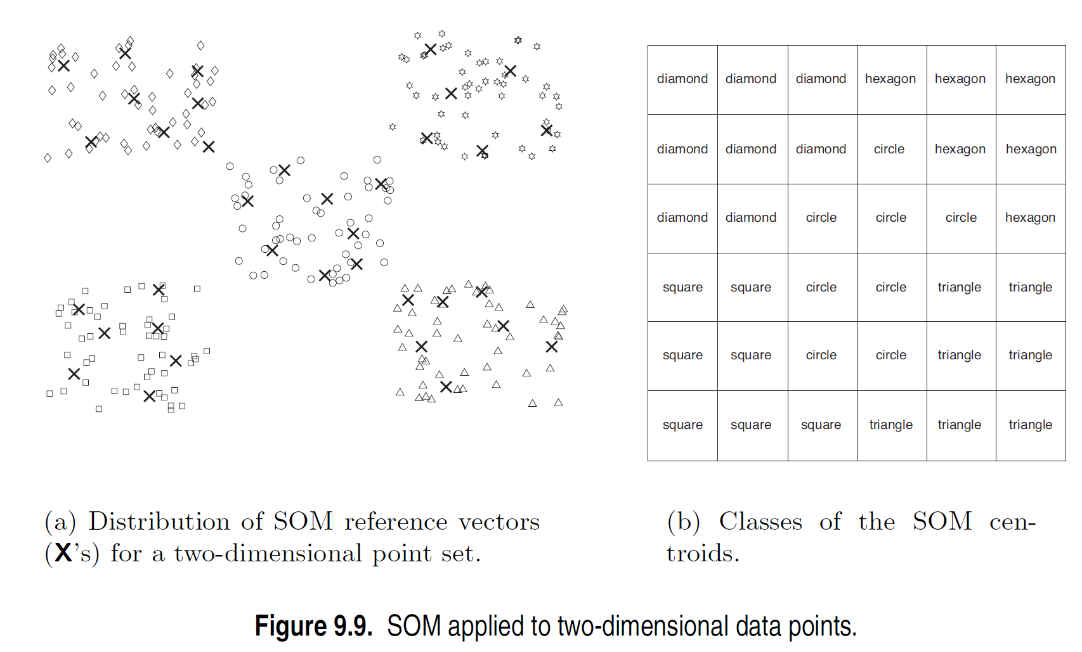
Another SOM Example: 2D Points

Slide 23
Issues with SOM
High computational complexity
No guarantee of convergence
Choice of grid and other parameters is somewhat arbitrary
Lack of a specific objective function

Slide 24
Grid-based Clustering
A type of density-based clustering

Slide 25
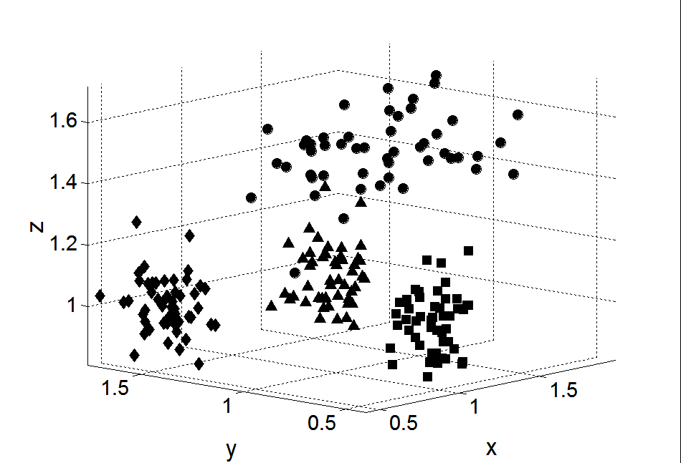
Subspace Clustering
Until now, we found clusters by considering all of the attributes
Some clusters may involve only a subset of attributes, i.e., subspaces of the data

Slide 26
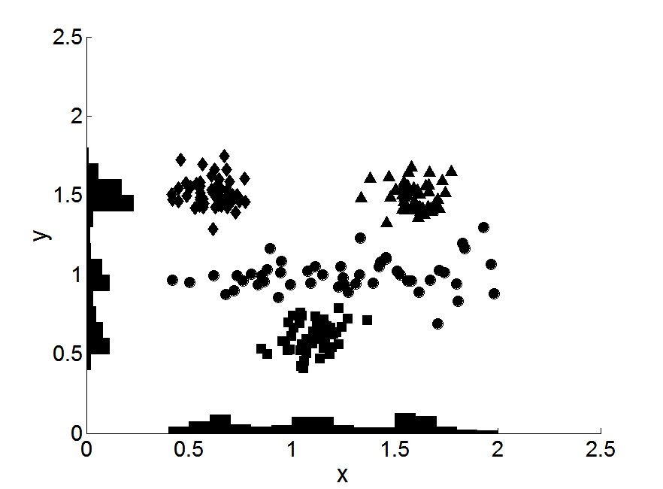
Clusters in subspaces

Slide 27
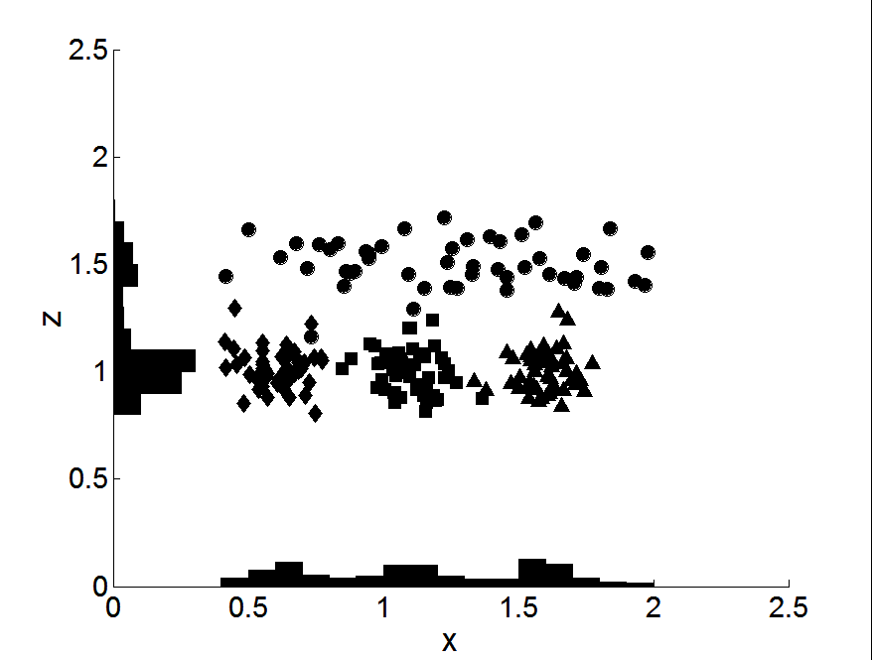
Clusters in subspaces

Slide 28
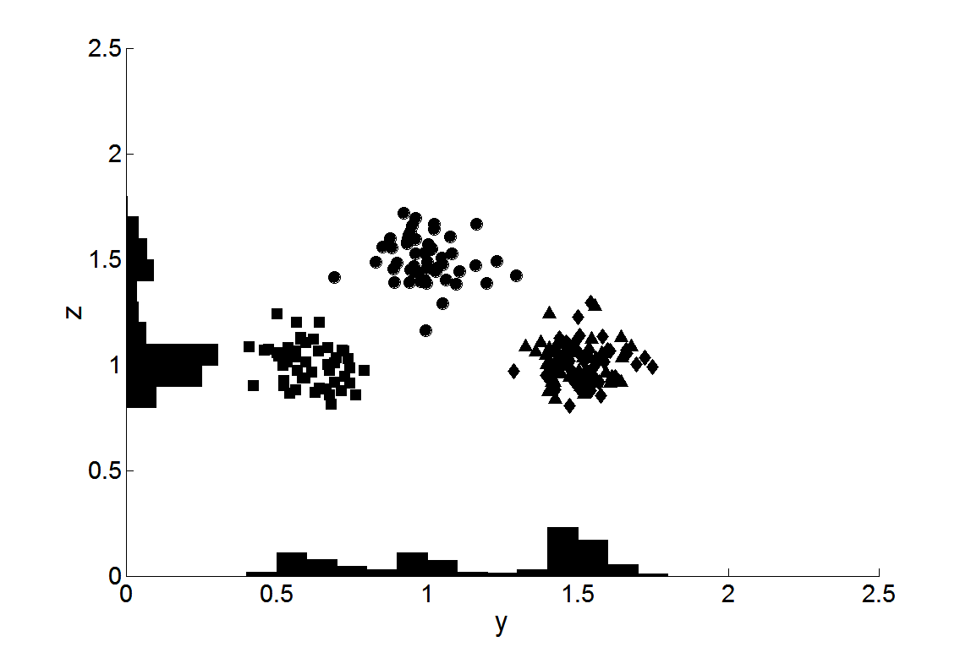
Clusters in subspaces

Slide 29
Clique – A Subspace Clustering Algorithm
A grid-based clustering algorithm that methodically finds subspace clusters
Partitions the data space into rectangular units of equal volume in all possible subspaces
Measures the density of each unit by the fraction of points it contains
A unit is dense if the fraction of overall points it contains is above a user specified threshold, τ
A cluster is a set of contiguous (touching) dense units

Slide 30
Clique Algorithm
It is impractical to check volume units in all possible subspaces, since there is an exponential number of such units
Monotone property of density-based clusters:
If a set of points cannot form a density based cluster in k dimensions, then the same set of points cannot form a density based cluster in all possible supersets of those dimensions
Very similar to Apriori algorithm
Can find overlapping clusters

Slide 31
Clique Algorithm

Slide 32
Limitations of Clique
Time complexity is exponential in number of dimensions
Especially if “too many” dense units are generated at lower stages
May fail if clusters are of widely differing densities, since the threshold is fixed
Determining appropriate threshold and unit interval length can be challenging

Slide 33
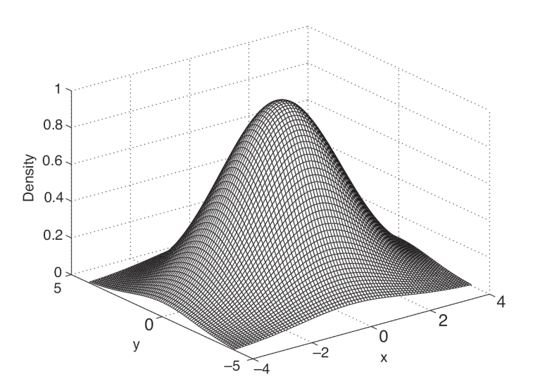
Denclue (DENsity CLUstering)
Based on the notion of kernel-density estimation
Contribution of each point to the density is given by an influence or kernel function
Overall density is the sum of the contributions of all points
Formula and plot of Gaussian Kernel

Slide 34
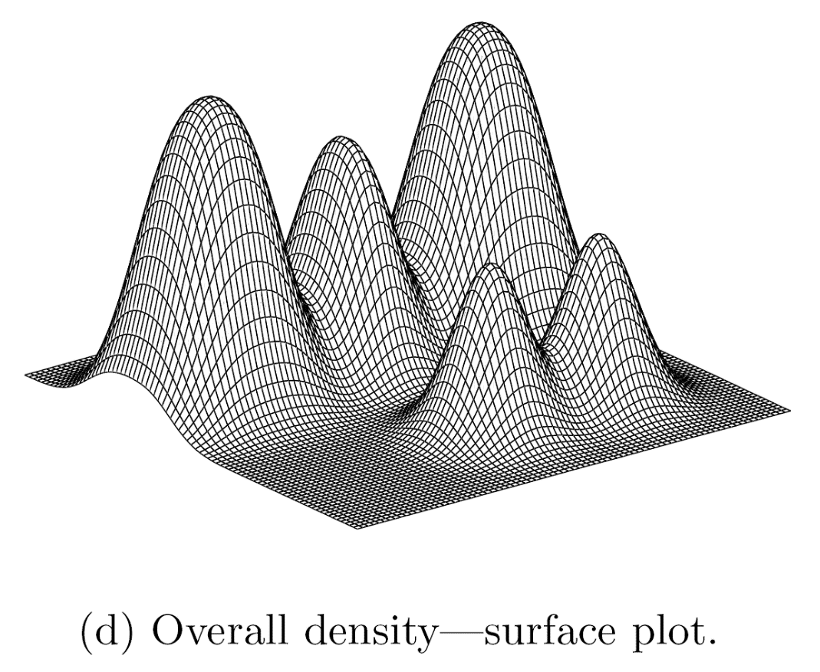
Example of Density from Gaussian Kernel

Slide 35
DENCLUE Algorithm
Find the density function
Identify local maxima (density attractors)
Assign each point to the density attractor
Follow direction of maximum increase in density
Define clusters as groups consisting of points associated with density attractor
Discard clusters whose density attractor has a density less than a user specified minimum, ξ
Combine clusters connected by paths of points that are connected by points with density above ξ

Slide 36
Graph-Based Clustering: General Concepts
Graph-Based clustering needs a proximity graph
Each edge between two nodes has a weight which is the proximity between the two points
Many hierarchical clustering algorithms can be viewed in graph terms
MIN (single link) merges subgraph pairs connected with a lowest weight edge
Group Average merges subgraph pairs that have high average connectivity
In the simplest case, clusters are connected components in the graph.

Slide 37
Graph-Based Clustering: Chameleon
Based on several key ideas
Sparsification of the proximity graph
Partitioning the data into clusters that are relatively pure subclusters of the “true” clusters
Merging based on preserving characteristics of clusters

Slide 38
Graph-Based Clustering: Sparsification
The amount of data that needs to be processed is drastically reduced
Sparsification can eliminate more than 99% of the entries in a proximity matrix
The amount of time required to cluster the data is drastically reduced
The size of the problems that can be handled is increased

Slide 39
Graph-Based Clustering: Sparsification …
Clustering may work better
Sparsification techniques keep the connections to the most similar (nearest) neighbors of a point while breaking the connections to less similar points.
This reduces the impact of noise and outliers and sharpens the distinction between clusters.
Sparsification facilitates the use of graph partitioning algorithms (or algorithms based on graph partitioning algorithms)
Chameleon and Hypergraph-based Clustering

Slide 40
Limitations of Current Merging Schemes
Existing merging schemes in hierarchical clustering algorithms are static in nature
MIN:
Merge two clusters based on their closeness (or minimum distance)
GROUP-AVERAGE:
Merge two clusters based on their average connectivity

Slide 41
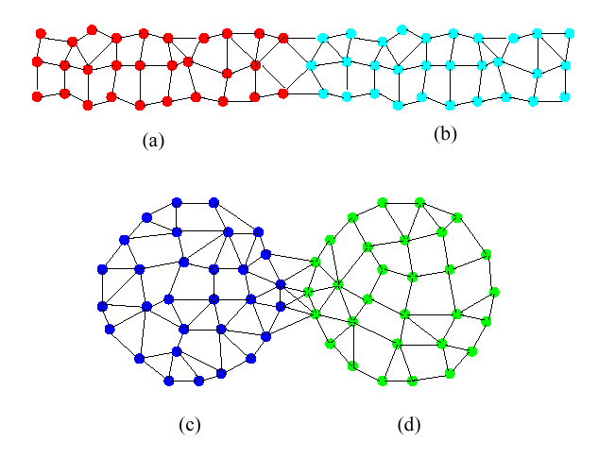
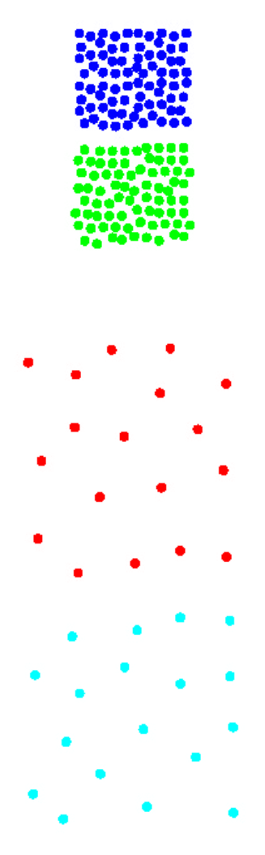
Limitations of Current Merging Schemes
(a)
(b)
(c)
(d)
Closeness schemes will merge (a) and (b)
Average connectivity schemes will merge (c) and (d)

Slide 42
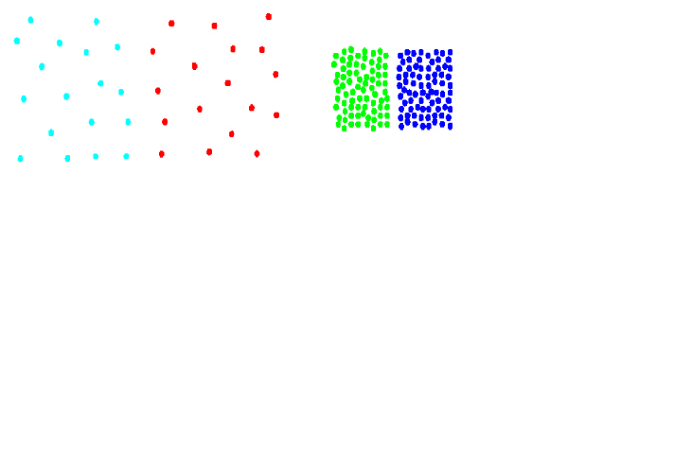
Chameleon: Clustering Using Dynamic Modeling
Adapt to the characteristics of the data set to find the natural clusters
Use a dynamic model to measure the similarity between clusters
Main properties are the relative closeness and relative inter-connectivity of the cluster
Two clusters are combined if the resulting cluster shares certain properties with the constituent clusters
The merging scheme preserves self-similarity

Slide 43
Relative Interconnectivity

Slide 44
Relative Closeness

Slide 45
Chameleon: Steps
Preprocessing Step: Represent the data by a Graph
Given a set of points, construct the k-nearest-neighbor (k-NN) graph to capture the relationship between a point and its k nearest neighbors
Concept of neighborhood is captured dynamically (even if region is sparse)
Phase 1: Use a multilevel graph partitioning algorithm on the graph to find a large number of clusters of well-connected vertices
Each cluster should contain mostly points from one “true” cluster, i.e., be a sub-cluster of a “real” cluster

Slide 46
Chameleon: Steps …
Phase 2: Use Hierarchical Agglomerative Clustering to merge sub-clusters
Two clusters are combined if the resulting cluster shares certain properties with the constituent clusters
Two key properties used to model cluster similarity:
Relative Interconnectivity: Absolute interconnectivity of two clusters normalized by the internal connectivity of the clusters
Relative Closeness: Absolute closeness of two clusters normalized by the internal closeness of the clusters

Slide 47
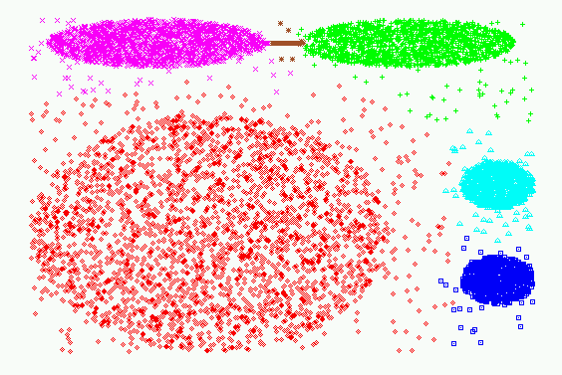
Experimental Results: CHAMELEON

Slide 48
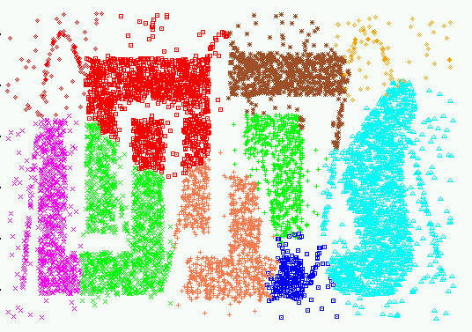
Experimental Results: CURE (10 clusters)

Slide 49
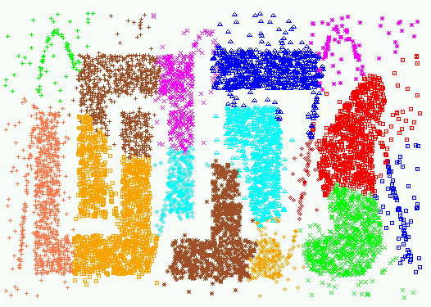
Experimental Results: CURE (15 clusters)

Slide 50
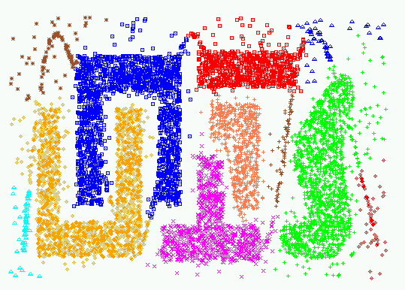
Experimental Results: CHAMELEON

Slide 51
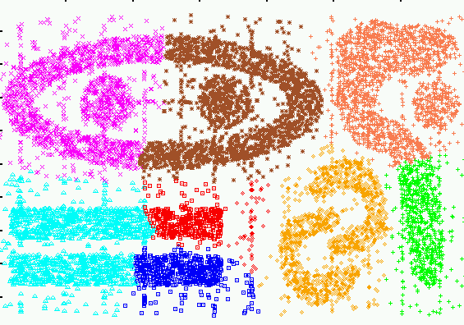
Experimental Results: CURE (9 clusters)

Slide 52
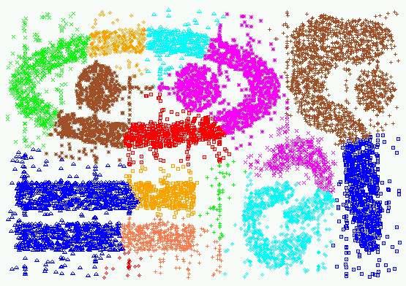
Experimental Results: CURE (15 clusters)

Slide 53
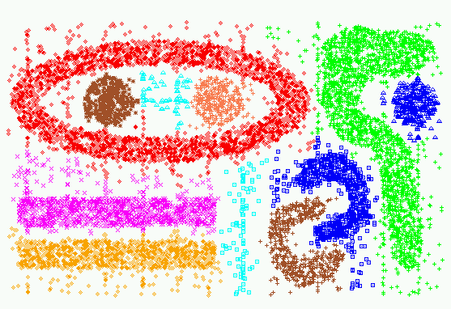
Experimental Results: CHAMELEON

Slide 54
Spectral Clustering
Spectral clustering is a graph-based clustering approach
Does a graph partitioning of the proximity graph of a data set
Breaks the graph into components, such that
The nodes in a component are strongly connected to other nodes in the component
The nodes in a component are weakly connected to nodes in other components
See simple example below (W is the proximity matrix)

Slide 55
Spectral Clustering
For the simple graph below, the proximity matrix can be written as
Because the graph consists of two connected components finding clusters is easy.
More generally, we need an automated approach
Must be able to handle graphs where the components are not completely separate
Spectral graph partitioning provides such an approach
Based on eigenvalue decomposition of a slight modification of the proximity matrix.

Slide 56
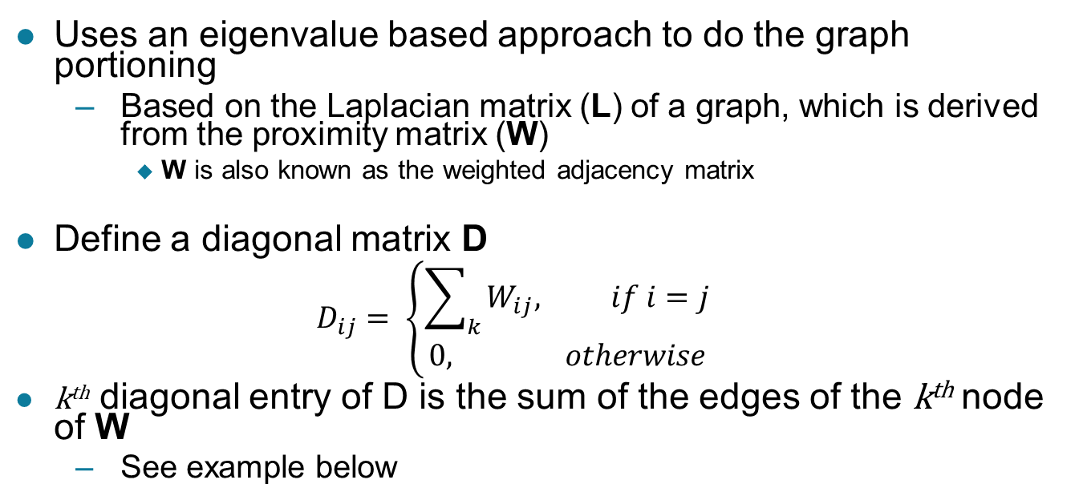
Clustering via Spectral Graph Partitioning
Uses an eigenvalue based approach to do the graph portioning
Based on the Laplacian matrix (L) of a graph, which is derived from the proximity matrix (W)
W is also known as the weighted adjacency matrix
Define a diagonal matrix D
$$D_{ij}= \left\{\begin{aligned}\sum_{k}{W_{ij}, if i=j} \\ 0, otherwise\end{aligned}\right.$$
k^{th} diagonal entry of D is the sum of the edges of the k^{th} node of W
See example below

Slide 57
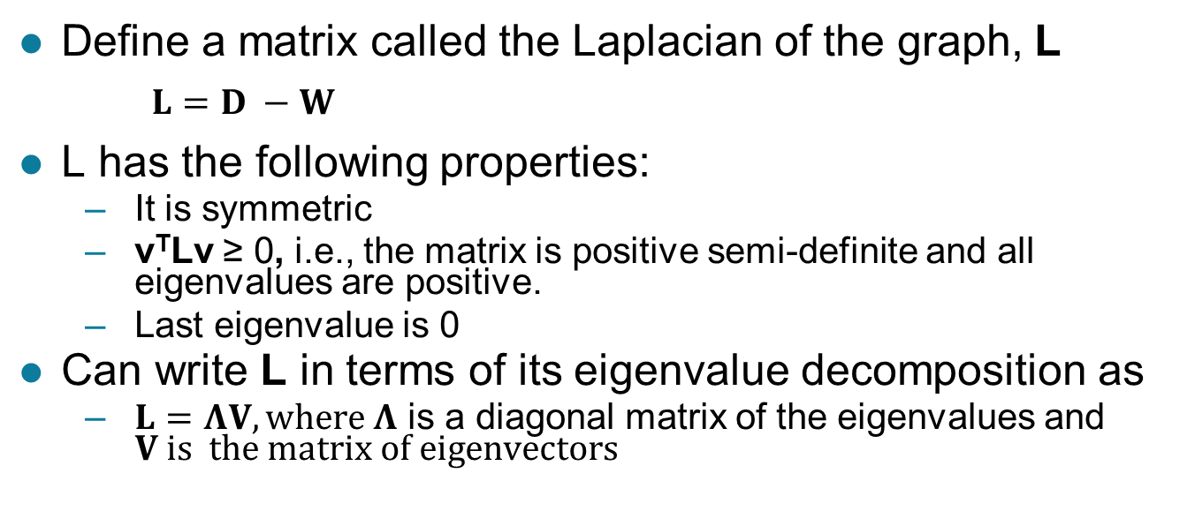
Clustering via Spectral Graph Partitioning …
Define a matrix called the Laplacian of the graph, L
$L=D −W$
L has the following properties:
It is symmetric
v^{T}Lv ≥ 0, i.e., the matrix is positive semi-definite and all eigenvalues are positive.
Last eigenvalue is 0
Can write L in terms of its eigenvalue decomposition as
$L=ΛV, where Λ$ is a diagonal matrix of the eigenvalues and $V is the matrix of eigenvectors$

Slide 58
A Slightly More Complicated Example

Slide 59
Spectral Graph Clustering Algorithm
Given the Laplacian of a graph, it is easy to define a spectral graph clustering algorithm
We simply apply k-means to the matrix consisting of the first k eignenvectors of L
Note that we cluster the rows of that matrix

Slide 60
Application of K-means and Spectral Clustering to a 2-D Ring

Slide 61
Strengths and Limitations
Can detect clusters of different shape and sizes
Sensitive to how graph is created and sparsified
Sensitive to outliers
Time complexity depends on the sparsity of the data matrix
Improved by sparsification

Slide 62
Graph-Based Clustering: SNN Approach
Shared Nearest Neighbor (SNN) graph: the weight of an edge is the number of shared nearest neighbors between vertices given that the vertices are connected
i
j
i
j
4

Slide 63
Graph-Based Clustering: SNN Approach
Shared Nearest Neighbor (SNN) graph: the weight of an edge is the number of shared neighbors between vertices given that the vertices are connected
i
j
i
j
4
If two points are similar to many of the same points, then they are likely similar to one another, even if a direct measurement of similarity does not indicate this.

Slide 64
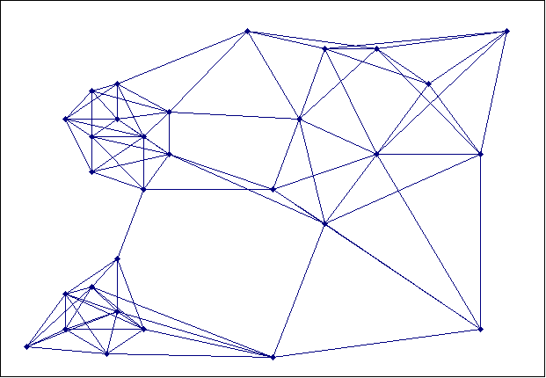
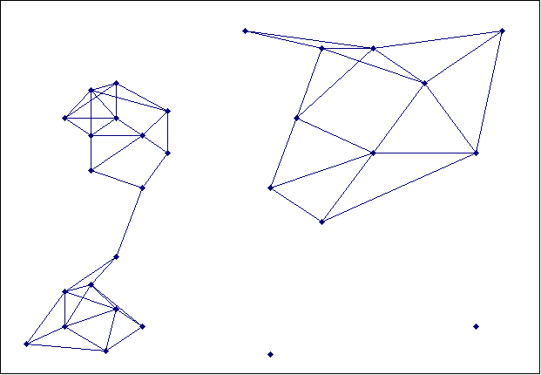
Creating the SNN Graph
Sparse Graph
Link weights are similarities between neighboring points
Shared Near Neighbor Graph
Link weights are number of Shared Nearest Neighbors

Slide 65
Jarvis-Patrick Clustering
First, the k-nearest neighbors of all points are found
In graph terms this can be regarded as breaking all but the k strongest links from a point to other points in the proximity graph
A pair of points is put in the same cluster if
any two points share more than T neighbors and
the two points are in each others k nearest neighbor list
For instance, we might choose a nearest neighbor list of size 20 and put points in the same cluster if they share more than 10 near neighbors
Jarvis-Patrick clustering is too brittle

Slide 66
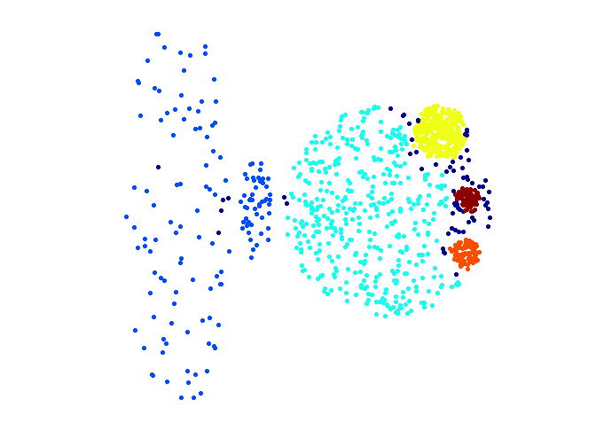
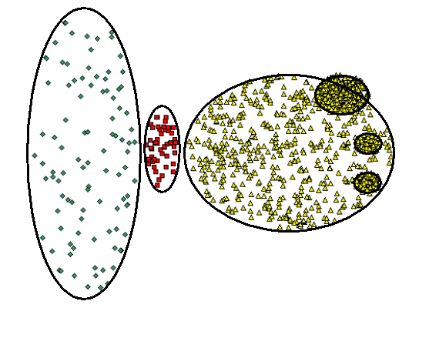
When Jarvis-Patrick Works Reasonably Well
Original Points
Jarvis Patrick Clustering
6 shared neighbors out of 20

Slide 67
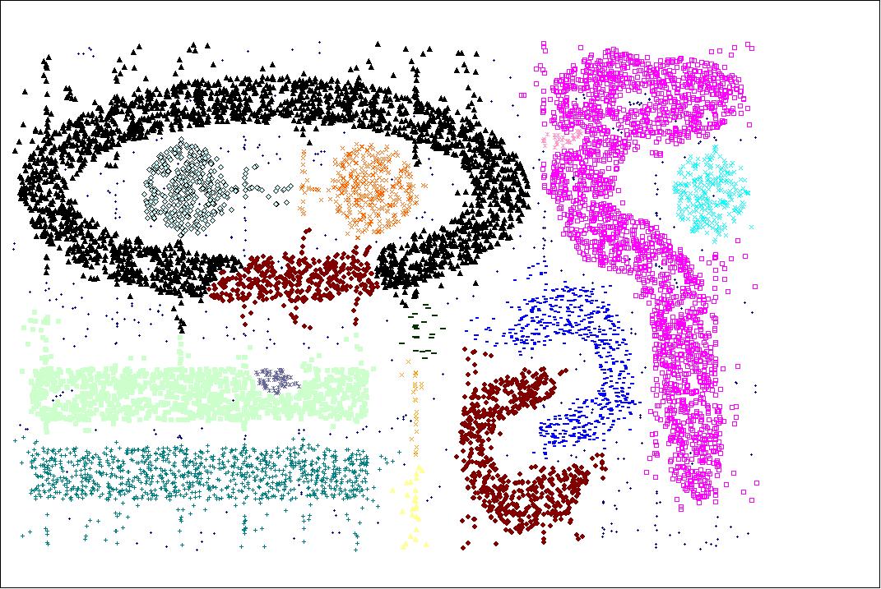
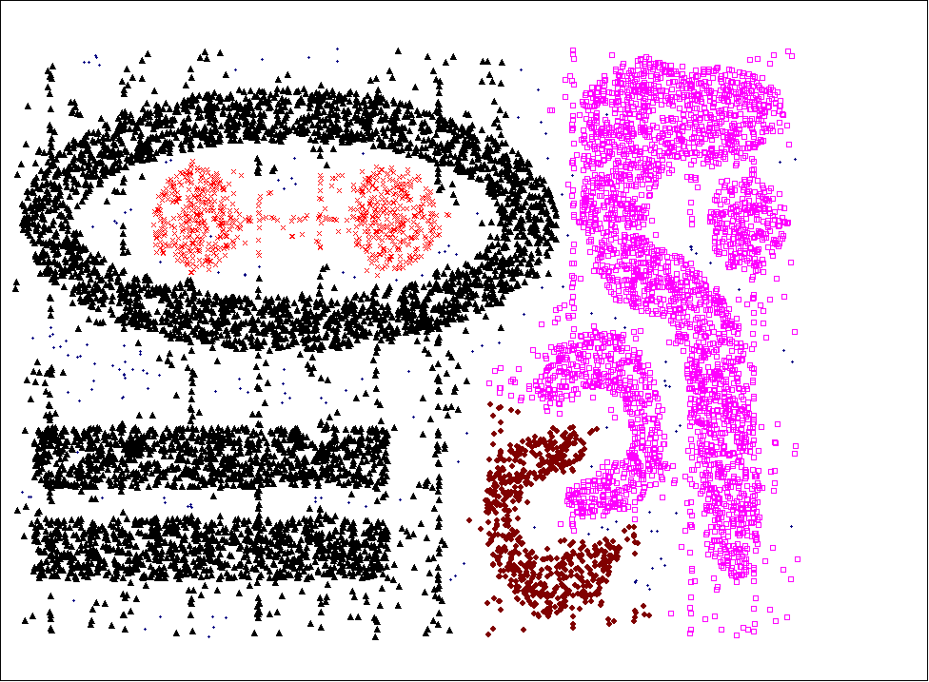
When Jarvis-Patrick Does NOT Work Well
Smallest threshold, T, that does not merge clusters.
Threshold of T - 1

Slide 68
SNN Density-Based Clustering
Combines:
Graph based clustering (similarity definition based on number of shared nearest neighbors)
Density based clustering (DBScan-like approach)
SNN density measures whether a point is surrounded by similar points (with respect to its nearest neighbors)

Slide 69
SNN Clustering Algorithm
Compute the similarity matrix This corresponds to a similarity graph with data points for nodes and edges whose weights are the similarities between data points
Sparsify the similarity matrix by keeping only the k most similar neighbors This corresponds to only keeping the k strongest links of the similarity graph
Construct the shared nearest neighbor graph from the sparsified similarity matrix. At this point, we could apply a similarity threshold and find the connected components to obtain the clusters (Jarvis-Patrick algorithm)
Find the SNN density of each Point. Using a user specified parameters, Eps, find the number points that have an SNN similarity of Eps or greater to each point. This is the SNN density of the point

Slide 70
SNN Clustering Algorithm …
Find the core points Using a user specified parameter, MinPts, find the core points, i.e., all points that have an SNN density greater than MinPts
Form clusters from the core points If two core points are within a “radius”, Eps, of each other they are placed in the same cluster
Discard all noise points All non-core points that are not within a “radius” of Eps of a core point are discarded
Assign all non-noise, non-core points to clusters This can be done by assigning such points to the nearest core point
(Note that steps 4-8 are DBSCAN)

Slide 71
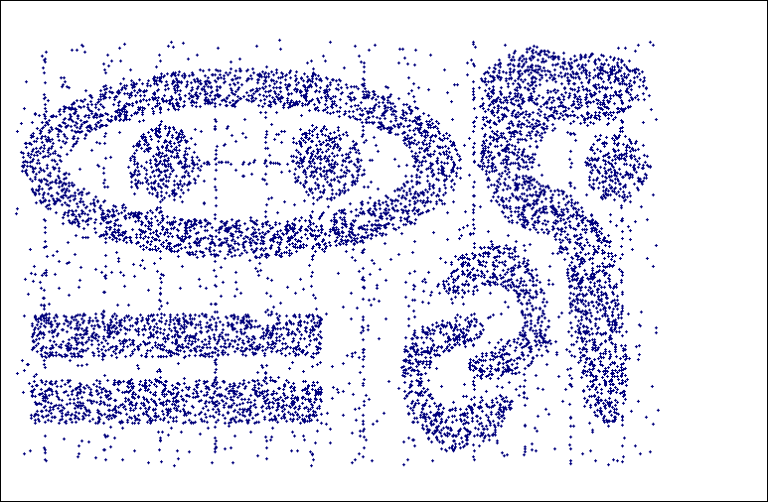
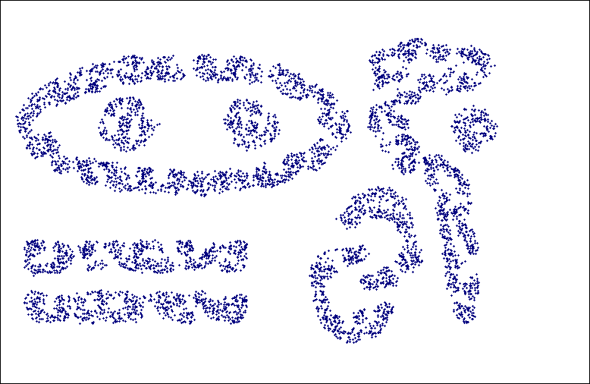
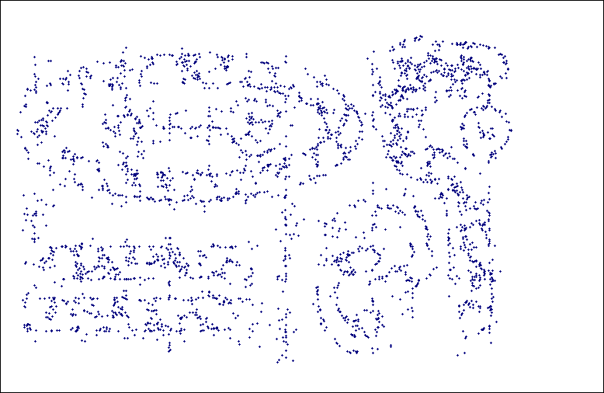
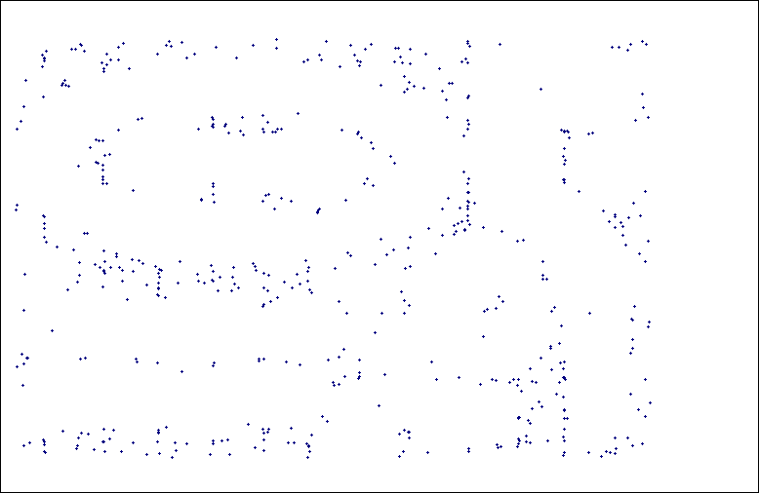
SNN Density
a) All Points b) High SNN Density
c) Medium SNN Density d) Low SNN Density

Slide 72
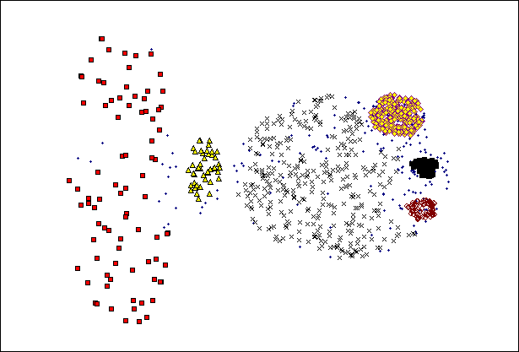
SNN Clustering Can Handle Differing Densities
Original Points
SNN Clustering

Slide 73
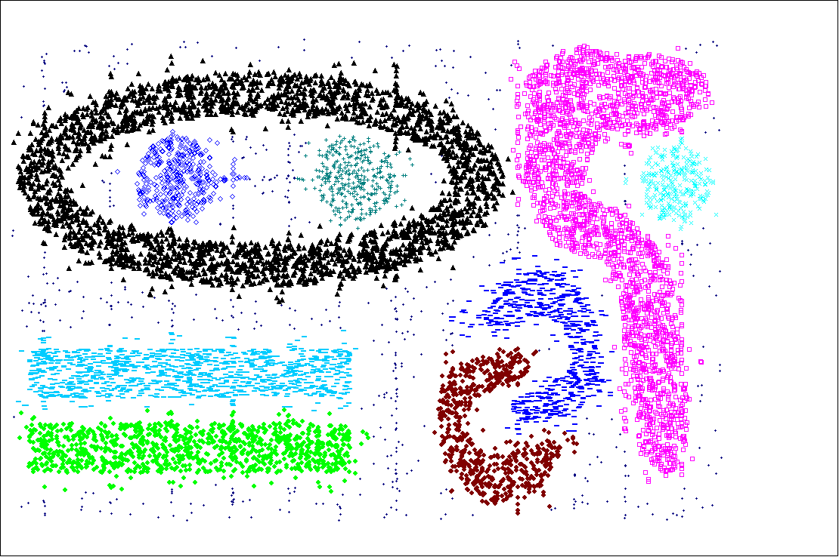
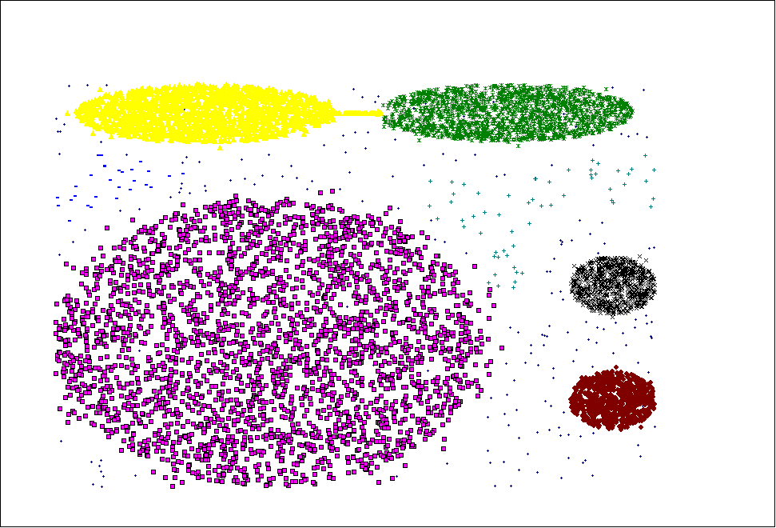
SNN Clustering Can Handle Other Difficult Situations

Slide 74
SNN Clusters in Sea-Surface Temperature (SST) Time-series Data Steinbach, et al (KDD 2003)

Slide 75
SST Clusters that Correspond to El Nino Climate Indices Steinbach, et al (KDD 2003)
75 78 67 94
El Nino Regions Defined by Earth Scientists
SNN clusters of SST that are highly correlated with El Nino indices, ~ 0.93 correlation.

Slide 76
SNN Clusters in Sea-Level-Pressure (SLP) Time-series Data Steinbach, et al (KDD 2003)
SNN Clusters of SLP.
SNN Density of Points on the Globe.

Slide 77
Pairs of SLP Clusters that Correspond to El-Nino SOI
Centroids of SLP clusters 15 and 20
(near Darwin, Australia and Tahiti)
1982-1993.
Centroid of cluster 20 – Centroid of cluster 15
versus SOI

Slide 78
Limitations of SNN Clustering
Complexity of SNN Clustering is high
O( n * time to find numbers of neighbor within Eps)
In worst case, this is O(n²)
For lower dimensions, there are more efficient ways to find the nearest neighbors
R* Tree
k-d Trees
Parameterization is not easy

Slide 79
Characteristics of Data, Clusters, and Clustering Algorithms
A cluster analysis is affected by characteristics of
Data
Clusters
Clustering algorithms
Looking at these characteristics gives us a number of dimensions that you can use to describe clustering algorithms and the results that they produce
© Tan,Steinbach, Kumar Introduction to Data Mining 4/13/2006 79

Slide 80
Characteristics of Data
High dimensionality
Dimensionality reduction
Types of attributes
Binary, discrete, continuous, asymmetric
Mixed attribute types (e.g., some are continuous, others nominal)
Differences in attribute scales
Normalization techniques
Size of data set
Noise and Outliers
Properties of the data space
Can you define a meaningful centroid or a meaningful notion of density

Slide 81
Characteristics of Clusters
Data distribution
Parametric models
Shape
Globular or arbitrary shape
Differing sizes
Differing densities
Level of separation among clusters
Relationship among clusters
Subspace clusters

Slide 82
Characteristics of Clustering Algorithms
Order dependence
Non-determinism
Scalability
Number of parameters

Slide 83
Which Clustering Algorithm?
Type of Clustering
Taxonomy vs flat
Type of Cluster
Prototype vs connected reguions vs density-based
Characteristics of Clusters
Subspace clusters, spatial inter-relationships
Characteristics of Data Sets and Attributes
Noise and Outliers
Number of Data Objects
Number of Attributes
Algorithmic Considerations

Slide 84
Comparison of MIN and EM-Clustering
We assume EM clustering using the Gaussian (normal) distribution.
MIN is hierarchical, EM clustering is partitional.
Both MIN and EM clustering are complete.
MIN has a graph-based (contiguity-based) notion of a cluster, while EM clustering has a prototype (or model-based) notion of a cluster.
MIN will not be able to distinguish poorly separated clusters, but EM can manage this in many situations.
MIN can find clusters of different shapes and sizes; EM clustering prefers globular clusters and can have trouble with clusters of different sizes.
Min has trouble with clusters of different densities, while EM can often handle this.
Neither MIN nor EM clustering finds subspace clusters.

Slide 85
Comparison of MIN and EM-Clustering
MIN can handle outliers, but noise can join clusters; EM clustering can tolerate noise, but can be strongly affected by outliers.
EM can only be applied to data for which a centroid is meaningful; MIN only requires a meaningful definition of proximity.
EM will have trouble as dimensionality increases and the number of its parameters (the number of entries in the covariance matrix) increases as the square of the number of dimensions; MIN can work well with a suitable definition of proximity.
EM is designed for Euclidean data, although versions of EM clustering have been developed for other types of data. MIN is shielded from the data type by the fact that it uses a similarity matrix.
MIN makes no distribution assumptions; the version of EM we are considering assumes Gaussian distributions.

Slide 86
Comparison of MIN and EM-Clustering
EM has an O(n) time complexity; MIN is O(n²log(n)).
Because of random initialization, the clusters found by EM can vary from one run to another; MIN produces the same clusters unless there are ties in the similarity matrix.
Neither MIN nor EM automatically determine the number of clusters.
MIN does not have any user-specified parameters; EM has the number of clusters and possibly the weights of the clusters.
EM clustering can be viewed as an optimization problem; MIN uses a graph model of the data.
Neither EM or MIN are order dependent.

Slide 87
Comparison of DBSCAN and K-means
Both are partitional.
K-means is complete; DBSCAN is not.
K-means has a prototype-based notion of a cluster; DB uses a density-based notion.
K-means can find clusters that are not well-separated. DBSCAN will merge clusters that touch.
DBSCAN handles clusters of different shapes and sizes; K-means prefers globular clusters.

Slide 88
Comparison of DBSCAN and K-means
DBSCAN can handle noise and outliers; K-means performs poorly in the presence of outliers
K-means can only be applied to data for which a centroid is meaningful; DBSCAN requires a meaningful definition of density
DBSCAN works poorly on high-dimensional data; K-means works well for some types of high-dimensional data
Both techniques were designed for Euclidean data, but extended to other types of data
DBSCAN makes no distribution assumptions; K-means is really assuming spherical Gaussian distributions

Slide 89
Comparison of DBSCAN and K-means
K-means has an O(n) time complexity; DBSCAN is O(n^2)
Because of random initialization, the clusters found by K-means can vary from one run to another; DBSCAN always produces the same clusters
DBSCAN automatically determines the number of clusters; K-means does not
K-means has only one parameter, DBSCAN has two.
K-means clustering can be viewed as an optimization problem and as a special case of EM clustering; DBSCAN is not based on a formal model.

